Slide 1
Planned marketing for Q3 NAM and other regions
DSG Home Page Graphic – Replace Oracle Streams with SharePlex (July-August)
Webinars-topics:
Achieving Oracle Database Scalability with or without RAC, presented by Clay Jackson, 8/20 (76 registered and 37 attended) - Internal
Minimal downtime maximum relaxation: how a travel company maintained availability while migrating to Oracle 12c, 9/24, 10 AM Pacific (Jeffrey Surretsky and Val at Hotwire.com, being promoted separately by 1105Media/ADT magazine)
Solutions for DB Upgrades (October, Clay Jackson, Kevin Stern)
Tech brief/white paper
Refresh of existing migration/upgrade white paper
Awareness: Pitfalls to DB upgrades (ebook)
Consideration: How to DB upgrades
Blogs:
Oracle Standard Edition Budget? Here’s How One Company Maximizes It. by Jeffrey Surretsky, 8/26
Easy database upgrades (Oracle 12c upgrades)
Case studies:
Bodybuilding.com: Data replication helps fitness company stream visitors to its website. 8/25, Note: video filming 9/15
Electronic Payment Exchange, interview with customer
Tradeshows (Dell World, OOW, PASS), various user groups, roadshows (APJ)
APJ Dell IMG Event (Singapore, 8/21) 44 registered, 33 attended, 27 MQLs (Doug Williams, LooTong Tan, Daniel Norwood)
NAM OOW demos with Dell San Disk Cache (SharePlex HA/DR)
Customer value profiles (Metlife, bodybuilding.com, Lands End, Calix) – project with consultant Karen Kirby
Commence work on SharePlex themed marketing: Continuous Database Availability (Once again enjoy your weekends, holidays and vacations - we've got your back!)

Slide 2
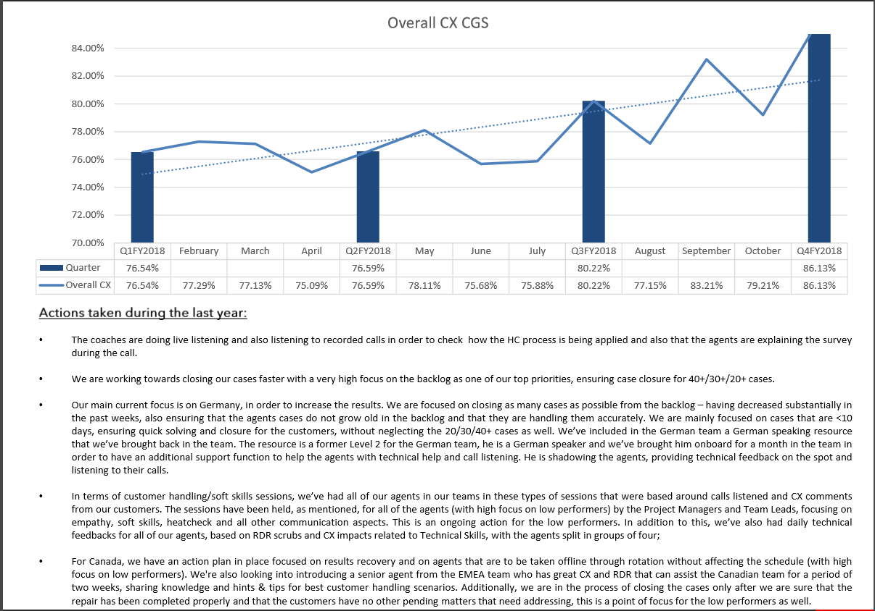
workbook - page 2

Slide 3
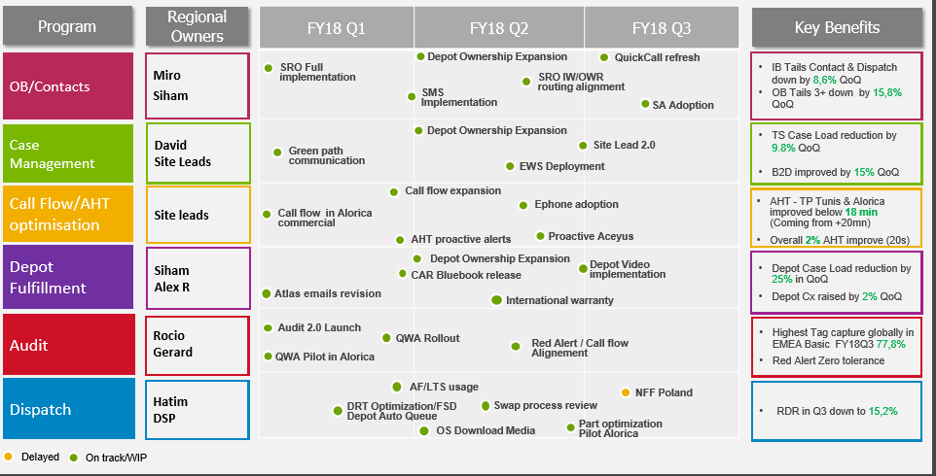
EMEA Basic | Initiatives Update

Slide 4
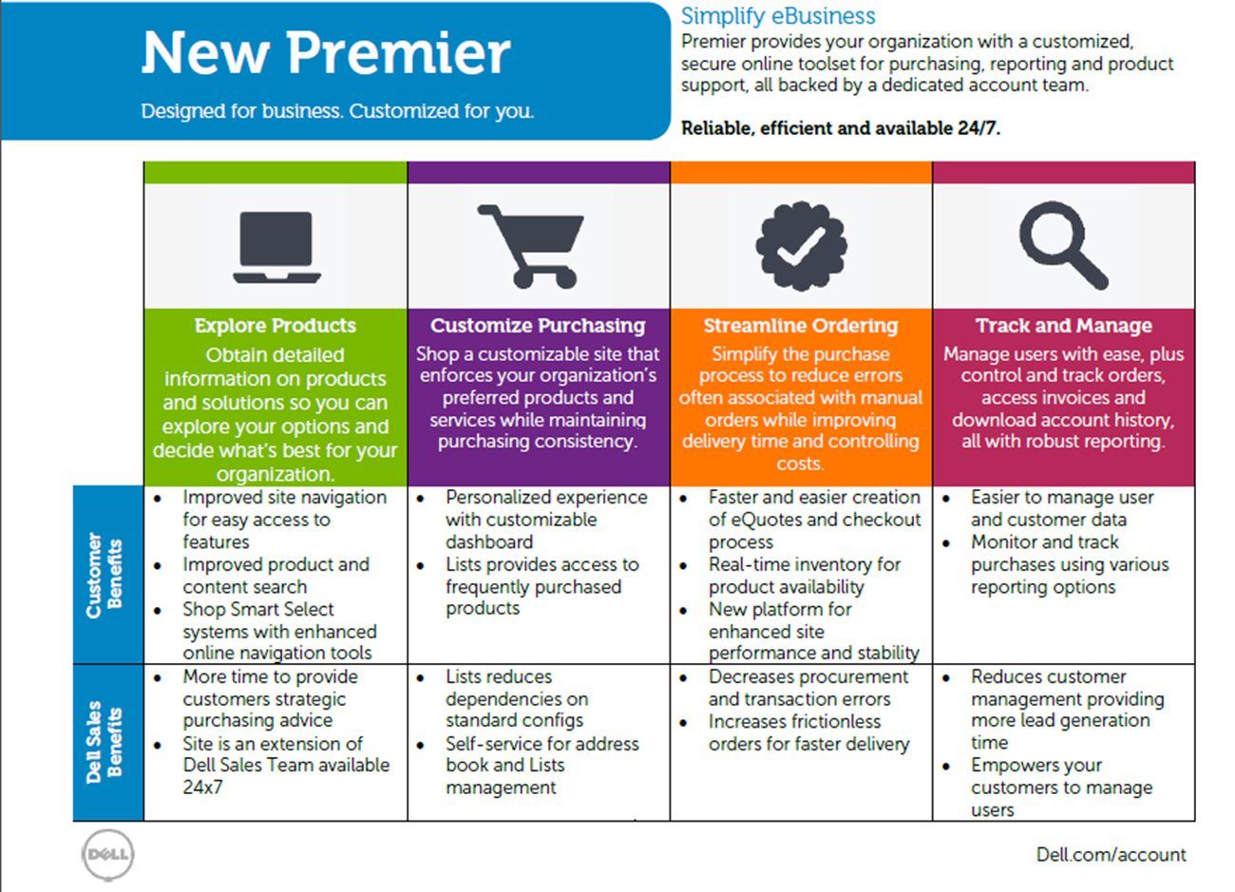

The Benefits of the New Dell Premier

Slide 5




Premier
Simplify eBusiness.
Premier provides your organization with a customized, secure online toolset for purchasing, reporting and product support, all backed by a dedicated account team.
Designed for business. Customized for you.
Reliable, efficient and available 24/7.
Explore products
Customize purchasing
Streamline ordering
Track and manage
Obtain detailed information on products and solutions so you can explore your options and decide what’s best for your organization.
Shop a customizable site that enforces your organization’s preferred products and services while maintaining purchasing consistency.
Simplify the purchase process to reduce errors often associated with manual orders while improving delivery time and controlling costs.
Manage users with ease, plus control and track orders, access invoices and download account history, all with robust reporting.

Slide 6
Why choose Dell Premier?
Explore products
Customize purchasing
Streamline ordering
Track and manage
Notes:
Explore: Obtain detailed information on products and solutions so you can explore your options and decide what’s best for your organization.
Customize Purchasing: Shop a customizable site that enforces your organization’s preferred products and services while maintaining purchasing consistency.
Streamline Ordering: Simplify the purchase process to reduce errors often associated with manual orders while improving delivery time and controlling costs.
Track and Manage: Manage users with ease, plus control and track orders, access invoices and download account history, all with robust reporting.

Slide 7
Customer Experience
Phone Support
We offer phone support 24 x 7 to answer all of your needs from the time you purchase to delivery.
Free delivery
In our delivery area we can deliver the product direct to your house, usually within 3 business days.
Web solutions and support
If you have any questions, our web site has chat capabilities and a constantly updated FAQ page.
Award winning service
We have been awarded “Best Customer Service” Department by the American Business Awards 3 times.

Slide 8
FY20 Plan
Before
Project
Description
Time
Investment
Executive Support
Improve campaign results management for Direct model. We need to centralize the results of all actions. This is the starting point for other projects, as Customer Centric analysis and Triggers.
Q2
Time from Mkt Ops and Programs
Yes.
Campaign Management (Indirect)
To implement the campaign management service and a campaign database for the Indirect target.
To be Quoted
(+-5k/Q)
Q1/Q2
-
CIOs/ Decision Maker
Task force to provide information about CIOs/Decision Maker. It includes external lists, researches, internal campaigns.
Q2
Provisioned
-
Resellers Contacts
To increase the contact promotability for Resellers implementing recurrent data quality actions.
Q1-Q4
6k/Q
-
Data Intelligence for Acquisition
To integrated Data Quality Plan and BI market information to acquire prospect lists.
Q3/Q4
Provisioned
-
Database Automation
Eliminate the greatest number of manual files and automate
the data feeds directly on Teradata.
Q1/Q2/Q3
-
-
LCM for Retail
Deploy LCM program for customers who bought Dell products through Retail. The idea is to promote the relationship with Dell and encourage a second purchase on Dell.com
Q1/Q2
-
-
LCM improvement (Commercial)
Review and improve LCM program for Direct customers.
Q2
-
-
Triggers
Improve the targeting processes creating triggers based on Customer Behavior in Events, othe emails, online behavior, etc.
Q2 / Q3
To be Quoted
Yes.
Notes:
APOS program is on hold:
This action was suppose to be cover by Robert Bryson from Leonor Bazaldua team but their budget was frozen.
We are evaluating send only the e-mail.

Slide 9
Planned marketing for Q3 FY19 NAM and other regions
Before
DSG Home Page Graphic – Replace Oracle Streams with SharePlex (July-August)
Webinars-topics:
Achieving Oracle Database Scalability with or without RAC, presented by Clay Jackson, 8/20 (76 registered and 37 attended) - Internal
Minimal downtime maximum relaxation: how a travel company maintained availability while migrating to Oracle 12c, 9/24, 10 AM Pacific (Jeffrey Surretsky and Val at Hotwire.com, being promoted separately by 1105Media/ADT magazine)
Solutions for DB Upgrades (October, Clay Jackson, Kevin Stern)
Tech brief/white paper
Refresh of existing migration/upgrade white paper
Awareness: Pitfalls to DB upgrades (ebook)
Consideration: How to DB upgrades
Blogs:
Oracle Standard Edition Budget? Here’s How One Company Maximizes It. by Jeffrey Surretsky, 8/26
Easy database upgrades (Oracle 12c upgrades)
Case studies:
Bodybuilding.com: Data replication helps fitness company stream visitors to its website. 8/25, Note: video filming 9/15
Electronic Payment Exchange, interview with customer
Tradeshows (Dell World, OOW, PASS), various user groups, roadshows (APJ)
APJ Dell IMG Event (Singapore, 8/21) 44 registered, 33 attended, 27 MQLs (Doug Williams, LooTong Tan, Daniel Norwood)
NAM OOW demos with Dell San Disk Cache (SharePlex HA/DR)
Customer value profiles (Metlife, bodybuilding.com, Lands End, Calix) – project with consultant Karen Kirby
Commence work on SharePlex themed marketing: Continuous Database Availability (Once again enjoy your weekends, holidays and vacations - we've got your back!)

Slide 10
ADSC System Exchange Program
Before
Policy
EXG Triggers
Policy and Procedures
Resources
EXG Team
# of resources
Grade levels
Roles and Responsibilities
Tech Support
Agent
Support Staff
Process
EXG Team
Engagement
Communication
RA Process
Agent to EXG Team
EXG Team to Agent
Customer
Templates (AutoSweet)
Intake
Project Distribution
PNP Validation
EXG Order Setup
Reporting
Tools
Delta
Dellstar
System EXG Assistant
Dell.com
GPT
GOV
Extractor
CLCA
Oracle Knowledge
Training
EXG Team
New process setup
Used process setup
Canada process setup
Agent
New hire
Vitality

Slide 11
Objectives
Determine the best architecture approach for product offerings that:
Simplifies and accelerates decision making around naming and architecture.
Reduces friction in product development, customer support, and consumer acceptance.
Accelerates growth opportunities and avoids limiters to innovation efforts.

Slide 12

Exercise: Simplify a Dell Slide
workbook - page 7

